Slide 1
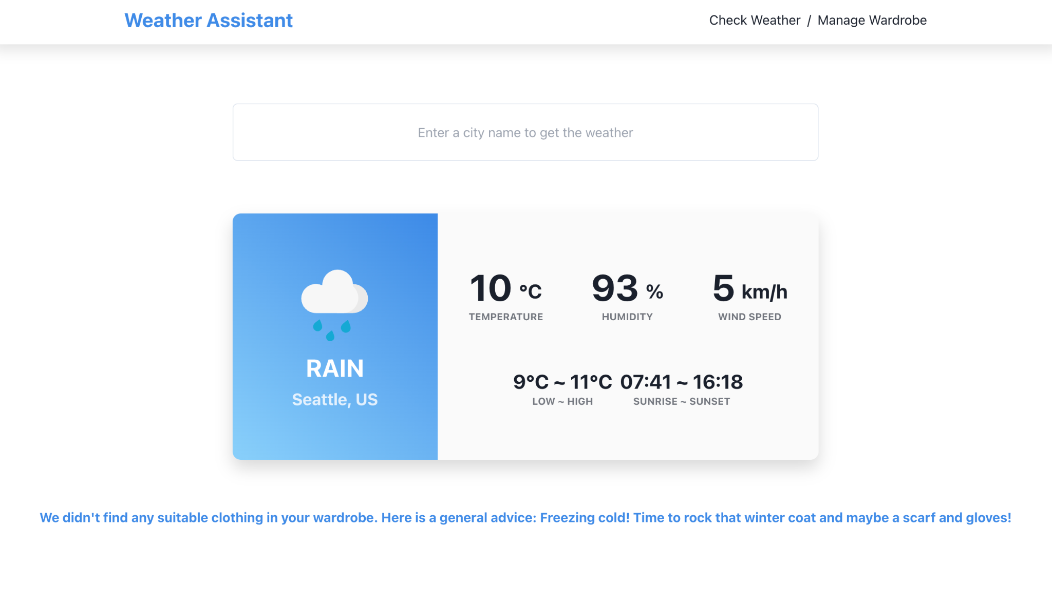
Weather Assistant
Integrates real-time weather forecasting with wardrobe management.
Providing personalized clothing recommendations and efficient wardrobe organization.
Group Name: HLJM
Jiejun Jiang: Database and API
Xinrui Shi: Weather Query
Shuangyi Hu: Wardrobe Management
Min Jia: Recommendation Algorithm
Notes:
Intro - Jiejun (basic idea about project + roles and responsibilities within the group)

Slide 2
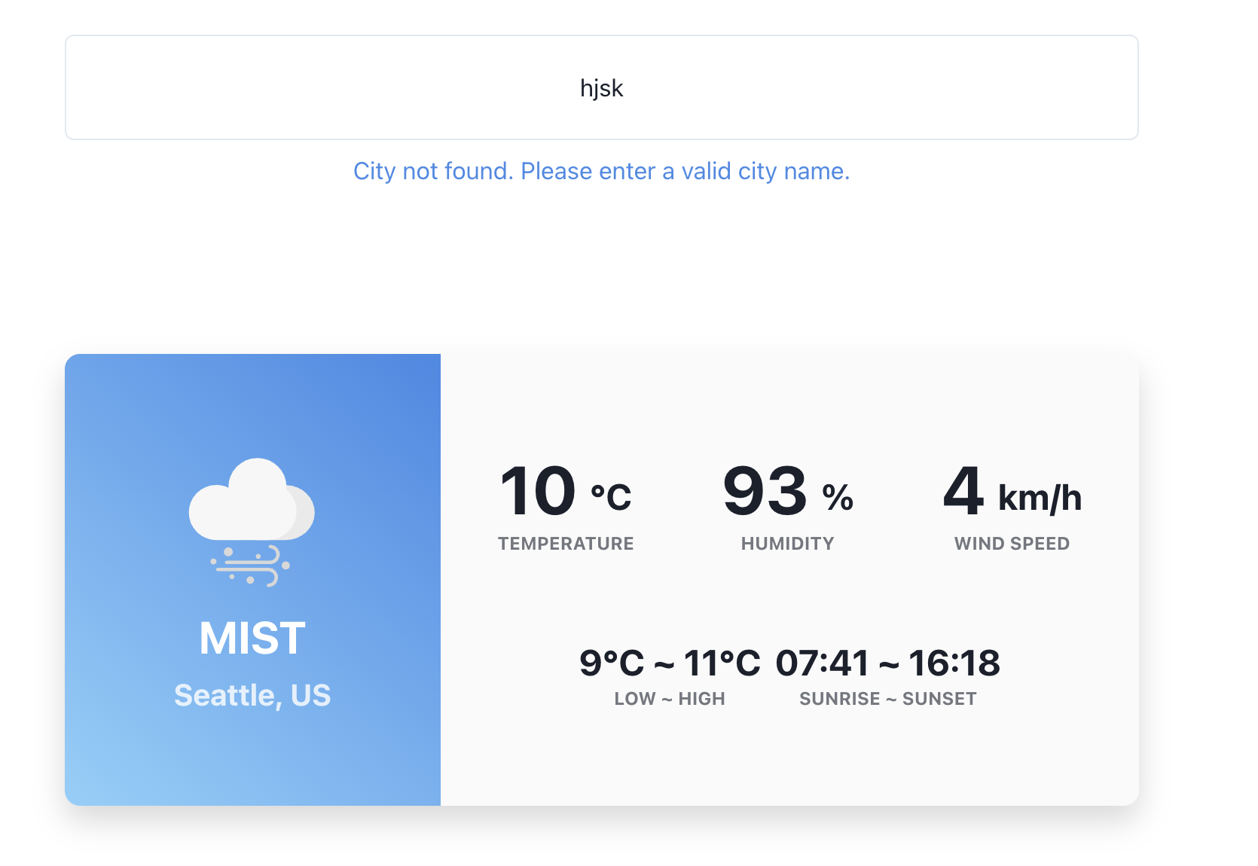
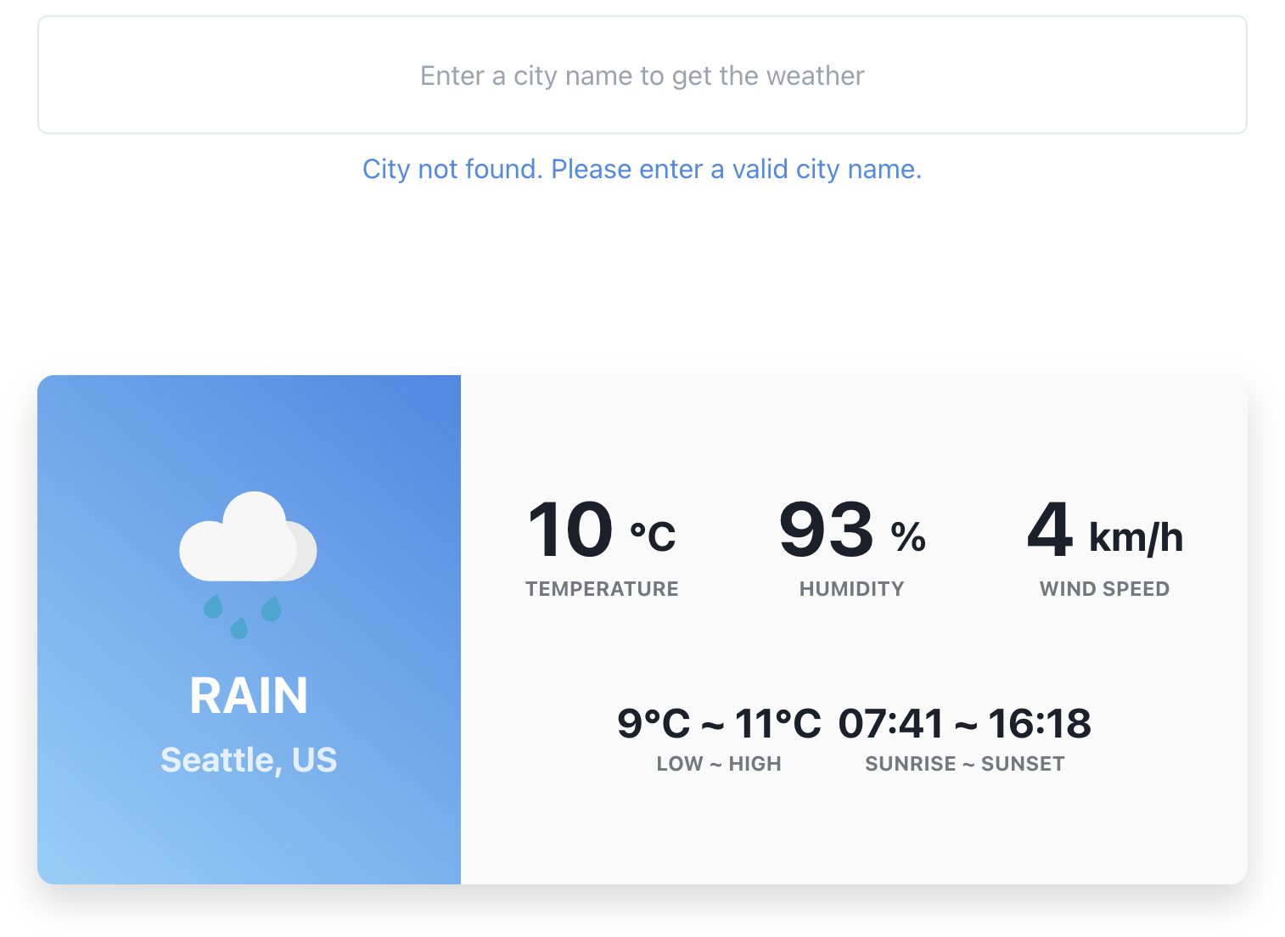
Weather Query Test Case
Enter an valid city name will show weather infomation.
Enter an invalid city name will display error message.
Notes:
Xinrui Shi

Slide 3
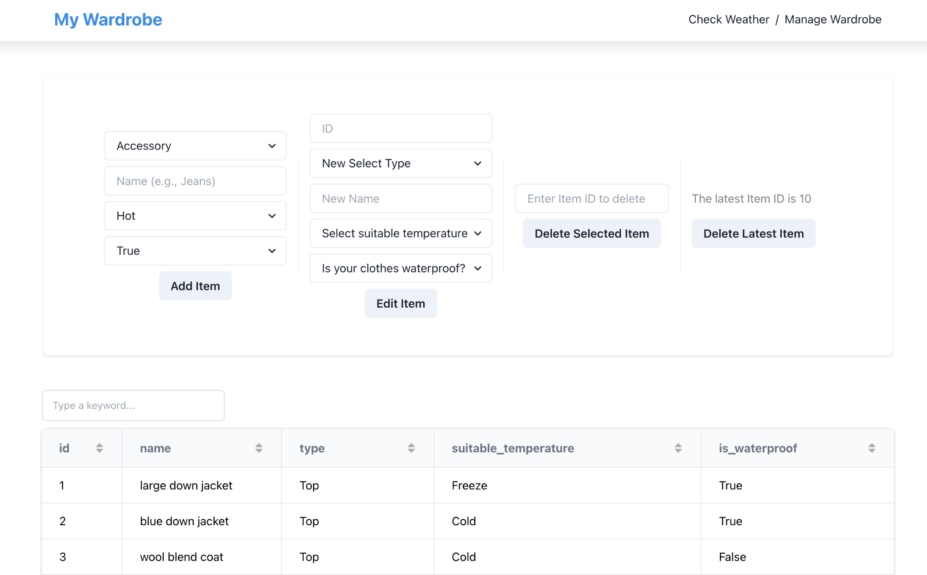
Wardrobe Management
Allowing users to add, edit, delete, and view wardrobe items.
Notes:
Xinrui Shi

Slide 4
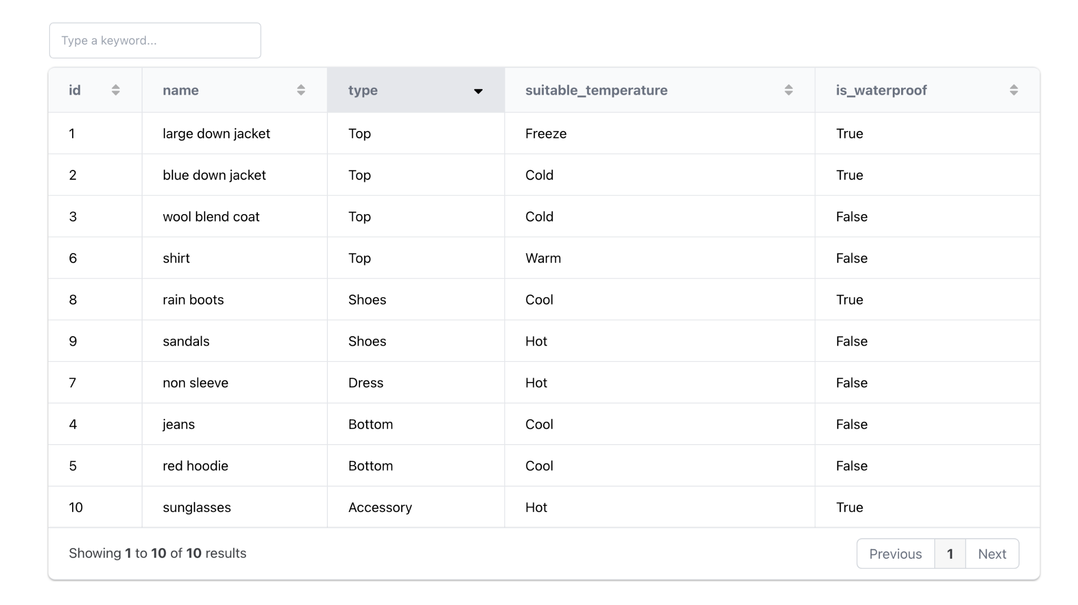
Wardrobe Display
The clothing items table allows for searching, sorting, and pagination.
Notes:
Xinrui Shi

Slide 5
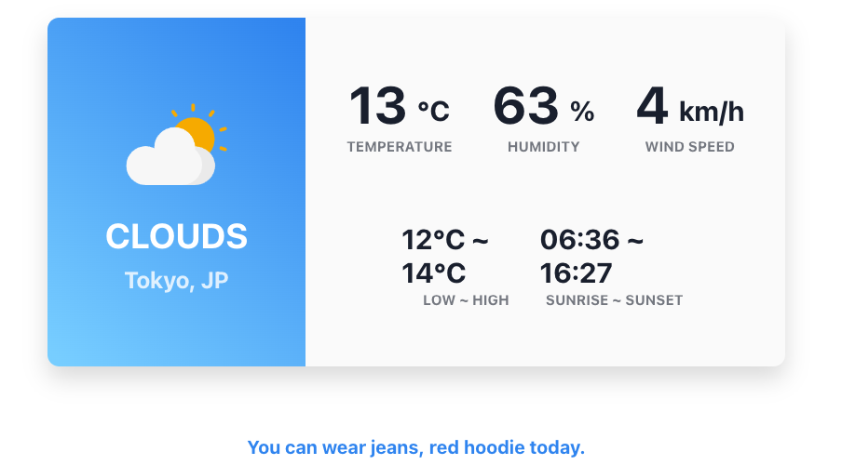
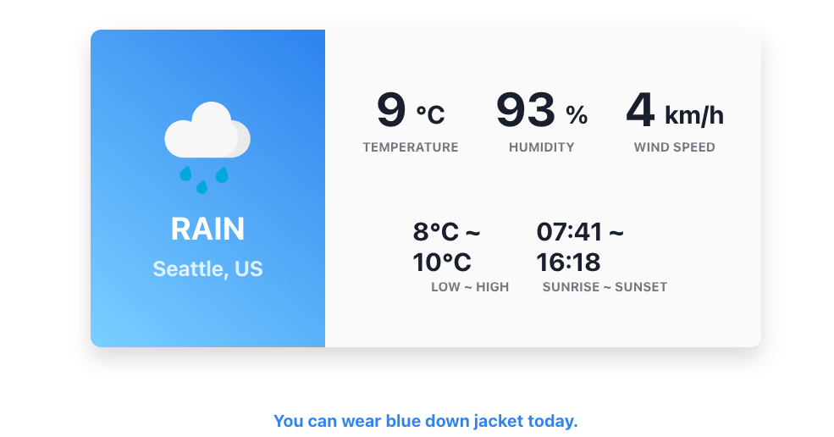
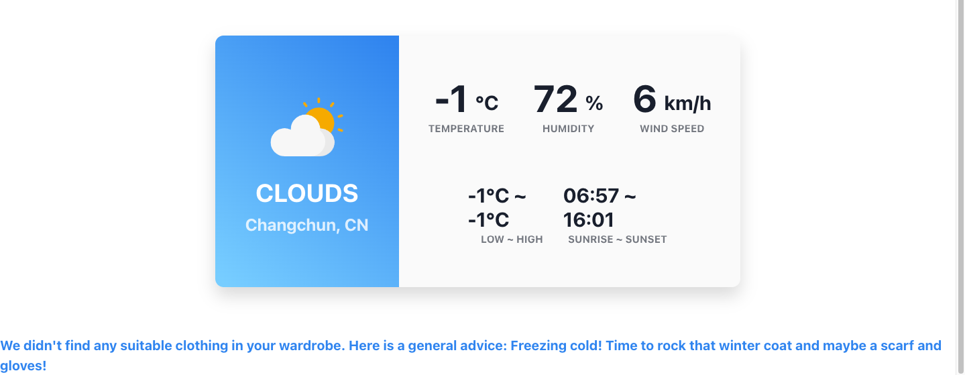
Clothing Suggestion Test Case
Provides clothing advice based on the weather condition and wardrobe items.
If there is no items in wardrobe, display a general advice.
Notes:
Xinrui Shi

Slide 6
Conclusion
Key Learnings:
API Mastery: Successfully integrated the OpenWeatherMap API for real-time weather data.
Framework Skills: Gained hands-on experience with the Reflex framework for responsive UI development.
Future Enhancements:
Automated wardrobe management with photo uploads and AI
Weather forecast visualization
Automatic city detection
Multi-language support,
Social media integration for sharing outfit choices
Direct purchasing options through retail platform integrations
Notes:
Intro - Jiejun (basic idea about project + roles and responsibilities within the group)

